Slide 1
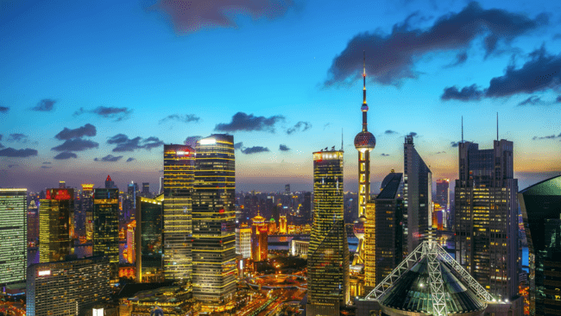
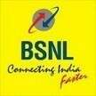
Smart Cities- BSNL Offerings

Slide 2
Contents
Smart Cities: Indian Perspective
BSNL Service Offerings
Our Credentials & Case Studies

Slide 3
India is experiencing rapid pace of urbanization with urban population expected to reach 590 Million by 2030
Population (In Millions) over Years
As per the 2011 Census, India’s cities are home to 377 million people, representing all sections of India’s society
53 One Mn+ cities in 2011 from 35 in 2001
Decadal Growth rate urban areas @ 31%
1/3 of population urban migrants
Rural to Urban Migration
Improved Standard of Living
Source: Census 2011
Causes
Population Growth Rate
Expansion of Industry and Trade
Expansion of Urban Areas
GDP to be 5 times by 2030
70% new employment generated in Cities
270 million people net increase in working age population
Source: India’s Urban awakening: Building inclusive cities, sustaining economic growth, Mckinsey Global Institute, 2010

Slide 4
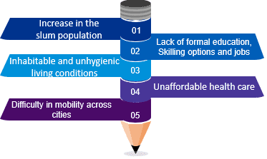
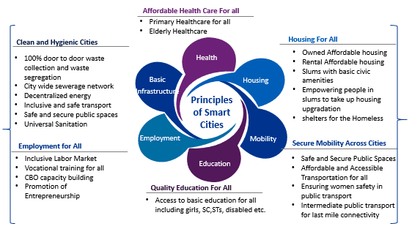
Hence there is a need to build smart cities that are smart not only physically but also technologically
Challenges due to increasing urbanization
These challenges give rise to the never ending cycle of Poverty
Poverty
Poor Living Conditions
Limited access to skilled jobs
Limited Access to Education
Poverty
There is a need to build cities that are based on 4 aspects of inclusiveness
Affordable
Accessible
Equitable
Sustainable

Slide 5
Smart Cities for Urbanization: India’s Perspective
Smart Cities has different connotation in India, than say, Europe. No universally accepted Definition!. Even within India, the idea of Smart City varies by stakeholders and cities. It is driven by,
level of existing degree of development
willingness to change and reform
resources and aspirations of the city
residents residents
Smart Cities Mission follows an India-centric approach - citizen driven, comprehensive and interconnected.
A Smart City is a city that harnesses emerging technologies such as the Internet of Things, Artificial Intelligence, Machine Learning and Big Data in order to make it more liveable, workable and sustainable.
A smart city with coordinated leadership and collaboration across government, industry and business, which leads the way and connects with its citizens
A city that applies technology
and innovation to ensure a cleaner and more sustainable future
A city that invests in innovation and provides a roadmap and infrastructure to support successful business outcomes and attract industry and investment in smart sectors
A city that makes life easier for everyone, which uses smart technology in its public places, and that develops new ways of connecting people and improving city amenity
Smart City Attributes
A city that invests in people and attracts talent to the area, which creates opportunities through emerging smart technologies and enables everyone to participate
A city with connected technology-enabled infrastructure for multiple modes of mobility, that innovates towards future transport modes and prioritises walking and

Slide 6
Smart Cities Ecosystem: “System of Systems” and related Services
Digital city eco-system components
Stakeholders
Local Citizens
Civil Servants
Businesses
Residents
Students
Business Travellers
Tourists
Channels
Smart Card
Smart TV
Wearable Devices
Smart Phone
Tablet
Digital Signage
PC
Smart Vehicles
Smart Services
Mobility
Safety
Energy
Buildings
Health
Education
Tourism
Retail
Environment
Government
Smart city platform
Next generation infrastructure
City connectivity infrastructure
City digital infrastructure
City security infrastructure
Citizens as sensors
Enabling levers
Governance
Open data
Innovation
Human Capital
Cyber-security
Policies
/ standards
Comms
PPP /
funding models

Slide 7
The core infrastructure elements in a smart city would include…
Integrated Command & Control Centre
Smart
Government
Network
backbone
Smart
Education
Smart
Healthcare
Smart
Transportation
Smart
Campus
Centralised monitoring of city operations
Accelerates emergency response with cross-agency collaboration
Simulates city operations and facilitates intelligent decision-making
Smooth functioning of government to provide an interconnected platform for multiple agencies
Video conferencing and support for mobile devices to help workers collaborate across any distance, from offices or in the field
One key element of smart cities is the network backbone, easy and ubiquitous WiFi access for the citizens
Provision of free internet at places like tourist destinations, railway and bus stations, important shopping areas etc.
Virtual education solution with high quality video resources
Smart classroom solution for education providing online content, smart boards and integrated School Management System
Life cycle management of Electronic Health Records (EHRs)
Provides high quality videos/ visualization to networks running 24/7 and wireless technologies for in-hospital or remote medical services
City-wide traffic video surveillance and traffic data collection
Real-time video makes emergency command and response much faster
Computerized evidence making drivers more aware of traffic laws
The campus video surveillance system is linked with intrusion alarms to strengthen campus security
Information exchange among people, vehicles, systems, and assets enable campus to be unified
Energy Management
Urban mobility
Smart Parking
This solution helps create powerful light-sensory networks to reduce energy consumption, costs and maintenance
This solution helps in gathering insights on movement of people in the city, holistic view of city traffic to improve planning etc.
Intelligent parking services through public Wi-Fi, video cameras, video analytics, and sensor-enabled parking management
Environmental Sensor
Waste management
Safety and security
Air quality control
Water quality control
Connection of sensors/ IoT platform
Real-time visualization of waste bin status, optimized route feature for
operators and collection managers etc.
Automated alerts from advanced video and social media analytics, predictive analysis by studying crime and incident trends
Notes:
https://www.cisco.com/c/en_in/solutions/industries/smart-connected-communities.html
http://e.huawei.com/sg/solutions/industries/smart-city
https://www.sterlitetech.com/smart-city-solutions

Slide 8
Contents
Smart Cities: Indian Perspective
BSNL Service Offerings
Our Credentials & Case Studies

Slide 9
BSNL – Key Highlights
01
MeitY Empaneled Cloud Service Provider
07
More than 2500 City Surveillance Cameras
02
100+ NOCs across the country
08
More than 1500 Smart Classrooms
03
More than 1 Lakh WI-FI Hotspots
09
Implemented Nation Wide Digital Platforms
04
5 Lakh Km+ Optical Fiber Network
10
Traffic Enforcement in more than 10+ Cities
05
Multiple Country Wide System Integration Projects
11
ICT Based SWM in more than 300+ ULBs
06
10 + Operating Data Centers
12
Launched E-Governance Portals & Applications

Slide 10
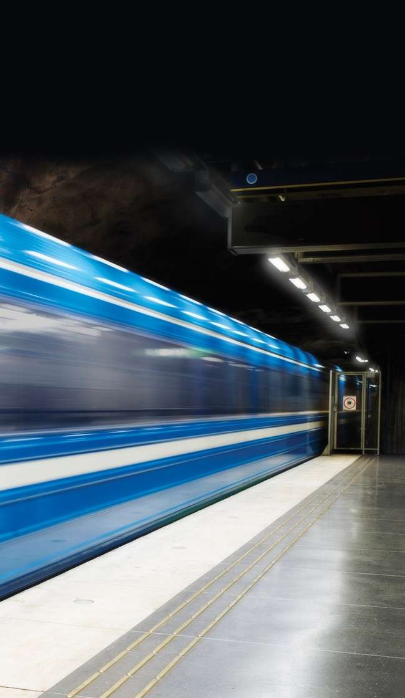
Being one of the largest player in the ICT Industry, BSNL feels it has a greater role to play than just being a Telecom Service Provider
Smart City Business Model
1
Winning Tender through RFP
2
Winning through Nomination
Identification of opportunity
Meetings with Smart City Officials
Educating Smart City Officials on possible solutions
Attend Smart City related workshops/meeting
Key Steps taken
Created solution documents for various Smart Solutions
Created customized solution for each smart city
Created Demonstration/PoC for various solutions
Actively pursuing in Nomination based projects in Smart Cities
Identification of RFP through
State E-Procurement Portals
Smart city Web Sites
Open Source
Options for Bidding
As a lead Bidder (Goa, Agartala bid)
Consortium Member (Kanpur, Allahabad, Nasik, Mangalore Bid)
Telecom Service Provider (TUFIDCO, Belgavi Bid)
Key Steps Taken
Partnered with Leading System Integrators & OEM
Participated in 4 Smart City opportunities and 8 are under process

Slide 11
BSNL has won Smart Solution projects worth more than INR 220+ Crores
Smart City | Smart Solution Component | Project Value
Pune | City Surveillance- Through RFP/Bidding Process | Rs. 74 Crore
Ahmedabad | Network Backbone for Smart City- Through RFP/Bidding Process | Rs.62.23 Cr.
Kanpur | Intelligent Traffic Management System with Video Analytics on Red Light Violation, Automatic Number Plate Recognition & Speed Violation Detection- Nomination based project | Rs. 5.10 Cr
All ULBs | E-SBM – Smart Solid Waste Management-Nomination based project | Rs.22 Cr.
Pune | Smart Class Rooms- Through RFP/Bidding Process | Rs.21 Cr.
Raipur City | Network Connectivity- Through RFP/Bidding Process | Rs.20 Cr.
Rajkot | City Surveillance related network backbone- Through RFP/Bidding Process | Rs.4.07 Cr.
Gwalior | Smart Class Rooms- Through RFP/Bidding Process | Rs. 3.5 Cr
Jabalpur | Smart Class Rooms- Through RFP/Bidding Process | Rs.2.98 Cr.
Indore | Smart Class Rooms- Through RFP/Bidding Process | Rs.2.67 Cr.
Hubli | 100 Wi-Fi Access points-Nomination based project | Rs. 1.65 Cr
Hazaribagh | Surveillance/CCTVs at 33 locations for Police Authorities- Nomination based project | Rs. 1 Cr
Bhagalpur | Smart pole and 05 Wi-Fi Hotspots- Nomination based project | Rs. 15 Lacs
Belgavi | Network Backbone and Wi-Fi hotspots- Through RFP/Bidding Process | Rs. 5.00 Cr

Slide 12
Our Smart City Partners
1
2
System Integrators
Solutions Partners
Infosys Ltd Recon Group-Teamax Smart Industry India PVT Ltd Aakash Universal Karvy Data Management Godrej & Boyce Mfg Co Ltd KPMG
Area | Solution Provider
Smart Parking | Elite IT services India PVT Ltd Vehant Technologies Pvt. Ltd Radius Synergies International
Smart Classroom | Smart Class Educational Services PVT LTD ExtraMarks Probit Plus Valuable Edutainment Pvt. Ltd
Solid Waste Management | Aeris Gaia Smart Cities Solutions Pvt. LTD RP Techsoft International Pvt. Ltd. Ajeevi Technologies Pvt Ltd
Command & Control Centre | Karaat Infrastructure Development Private Limited RP Techsoft International Pvt. Ltd. HPE
Citizen Centric application | Atishay Limited Civic Solution Pvt. Ltd CSDC India Indusnet Technologies PVT LTD Nippon Data System Ospyn Technology Aeris Communication India Pvt Ltd
Area | Solution Provider
Wi-Fi Hotspots | QuadGen Wireless Solutions Pvt. Ltd.
CCTV surveillance | Karaat Infrastructure Development Private Limited RP Techsoft International Pvt. Ltd. Lookman Electroplast Industries Limited
ITMS | Delhi Integrated Multi-Modal Transit System Ltd. PowerElectronics
Smart Poles | Nokia Recon Group
GIS | Integraph SG&I India Pvt Ltd Geovista Technologies Private Limited
OEM Aggregators | Inspira Integre solutions
IOT | Virgo Ishan InfoTech
Management Consultants
3

Slide 13
Contents
Smart Cities: Indian Perspective
BSNL Service Offerings
Our Credentials & Case Studies

Slide 14
We are working on a wide number of use cases...
Digital Signage
LED billboards to run multiple advertisements, navigation and civic
RFID
Authorised personnel can activate and monitor features of the Smart Pole
Electronic surveillance
CCTV’s for video surveillance
Traffic Management
Motion Detection, Traffic direction, Commuter Information, Buses
Charging points for E vehicles and Drone
Charging point for e vehicles and drones
Wi-Fi Hotspots
Customizable - free, limited access or prepaid
information
Panic Button/
Smart Lighting
Environmental and Meteorological data
Information
Parking Assistance
Proximity Sensor and data based applications for Smart Parking
emergency Assistance
Pre configured actions like intense LED rays, sirens, security assistance, two way communication etc,
Remotely controlled and energy saving (solar powered) lights
ICCC
Integrated Command and Control Centre
Seismic sensors, weather information and alerts on signboards, monitor air quality

Slide 15
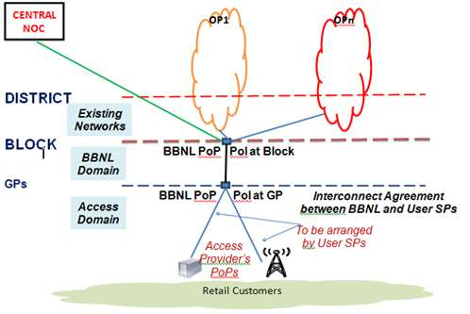
BSNL Prestigious Engagements – Bharat Net Phase 1
Bharat Net – National Optical Fiber Network Project
Bharat Net Concept Diagram
3,00,000 km of OFC laid and commissioned – unprecedented anywhere in the world
5,000 OLTEs integrated 1,25,000 GPON Equipment commissioned
Estimated project cost INR 20,000 Crore
Awarded by GoI on nomination basis due to BSNL’s capability, competency, project management skills and discipline

Slide 16
BSNL Prestigious Engagements – Network for Spectrum
NFS Project – Network for spectrum
Salient Features of the Programs
Implementing agency for Indian Defense, 57,100 km across India OFC Network
Key Components
Exclusive and Dedicated Nationwide DWDM based Optical Transmission Backbone Network for Armed Forces
Creation of dedicated IP Backbone Network
Next Generation Internet Protocol based converged network application
GIS based Optical Fibre Cable Network Management System
Activities Undertaken
Pan India level System Integration
Project Management
Installation, Network Planning, Training and Maintenance Support
Project Consultancy including Implementation and Support
Cost of equipment is approximately INR 13,000 Crore
Installed Central and Regional Network Operating Centers
Awarded by Ministry of Defense, GOI on Nomination Basis

Slide 17
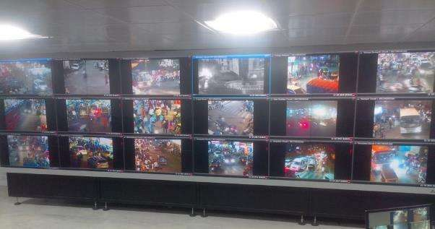
BSNL Smart City Engagements - Pune City Surveillance Project
BSNL in partnership with Allied Digital is implementing CCTC based surveillance system for Pune
INR 220+ Crore total Value of Project
1235 Camera installed
440 Locations
Salient Features of the System
Centralized Command Control and Data Center
Advanced cameras for ‘Automatic Number Plate Recognition with video and data analytics’
Response management
Integration of multiple systems – GIS, GPS, vehicle and crime database

Slide 18
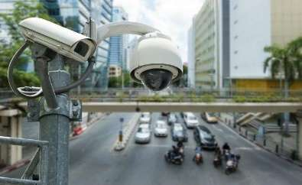
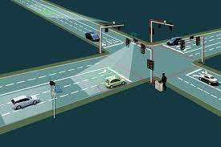
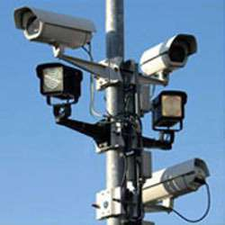
BSNL Smart City Engagements - Integrated Traffic Management, Kanpur
BSNL is implementing Intelligent Traffic Management System for Kanpur Smart City Limited
Salient Features of the System
Advanced cameras for ‘Automatic Number Plate Recognition/ Red Light Violation Detection with video and data analytics’
Response management
Corridor Management and Area Traffic Control System
Variable Message signage
Traffic Surveillance Cameras Through PTZ cameras for Violation detection and Incident management
16 Software License for ITMS (ANPR/RLVD/Over Speed) with IR Illuminator and Local Processor Unit and
INR 5 Crore total Value of Project
16 Box Type Cameras
10 pole Camera
50 Surveillance Type Cameras
10 Crossing Public Address System

Slide 19
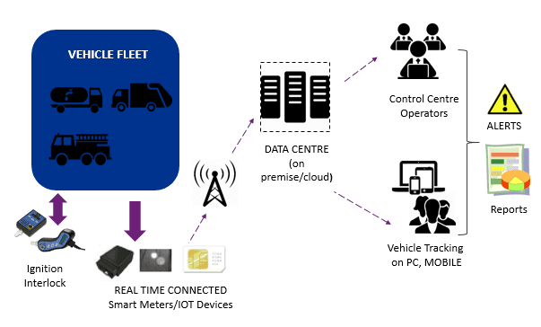
BSNL Smart City Engagements - ICT based Solid Waste Management, 4041 ULBs, MoUD
Solution Layout
Salient Features of the System
Monitoring of fleet status by GPS
MIS for waste collection and transportation
Real time SMS delivery for vehicle breakdown and maintenance
Citizen complaint management system and its redressal through SMS
Mobile application for capturing the status of cleaning site using date, time and location stamp and for attendance of staff
Mobile / Web-based applications to access relevant data around vehicle schedules, ETA/ETD, route deviations, vehicle performance etc.

Slide 20
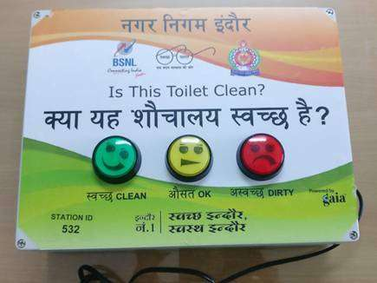
BSNL Smart City Engagements - Smart Toilets Online feedback, Municipal Authorities
Salient Features of the System
BSNL is offering Online feedback initiatives in 7 states covering 110 ULBs
1. Chhattisgarh
2. Himachal Pradesh
3. Jharkhand
4. Madhya Pradesh
5. Punjab
6. Uttar Pradesh
7. Uttarakhand
Public feedback on cleanliness
Fast-track redressal of deficiencies reported through feedback
Data of toilet usage and patterns leading to effective Planning of sanitation facilities
Service delivery improvement for public

Slide 21
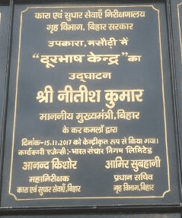
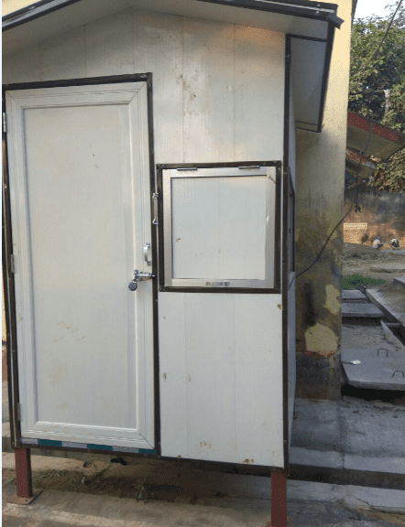
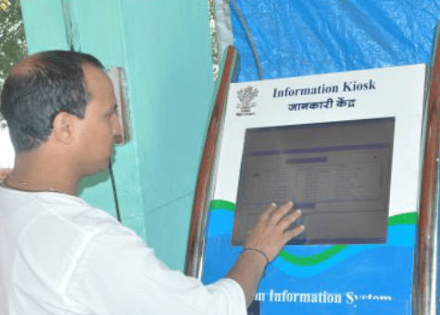
BSNL Smart City Engagements - Modernizing Indian Prisons, Bihar
BSNL is executing Prison Calling Project wherein 105 Calling and information kiosks in 57 Jails
3 Kiosks in each Central Jail
2 Kiosks in each District Jail
1 Kiosk in Sub-Jain
1 MBPS connection in each location
Salient Features of the System
Improves overall administration of Prisons
Data of all the calls are recorded on central server
Connectivity in Prison
Part of the e-Prison initiative of Indian Government

Slide 22
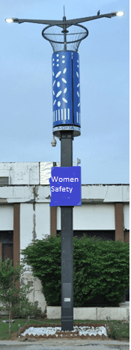
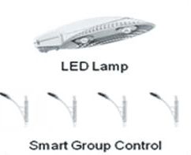
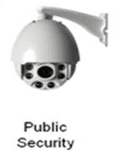
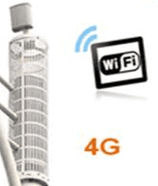
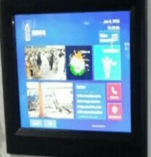
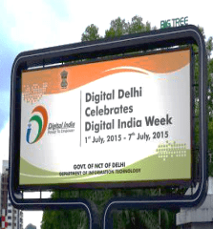
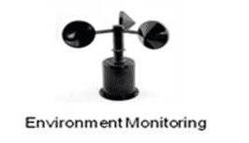
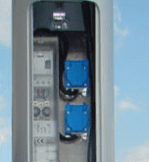
BSNL Smart City Engagements - Smart Pole in Bhagalpur, Ghazipur
BSNL has already installed smart poles in Bhagalpur, Ghazipur
Intelligent Lighting
LED streetlights
Solar power based illumines
Centralized Controlled
HR/HD Video Camera
Security Monitoring
Vehicle Monitoring
Wi-Fi Access Point
Wi-Fi Hotspot
Information Display
Advertising
Political news
Information release
Sensors
Environmental Sensors
Pollution detecting sensors
Emergency Call
Field Contact with Monitoring Centre/ Helpline stations

